Slide 1


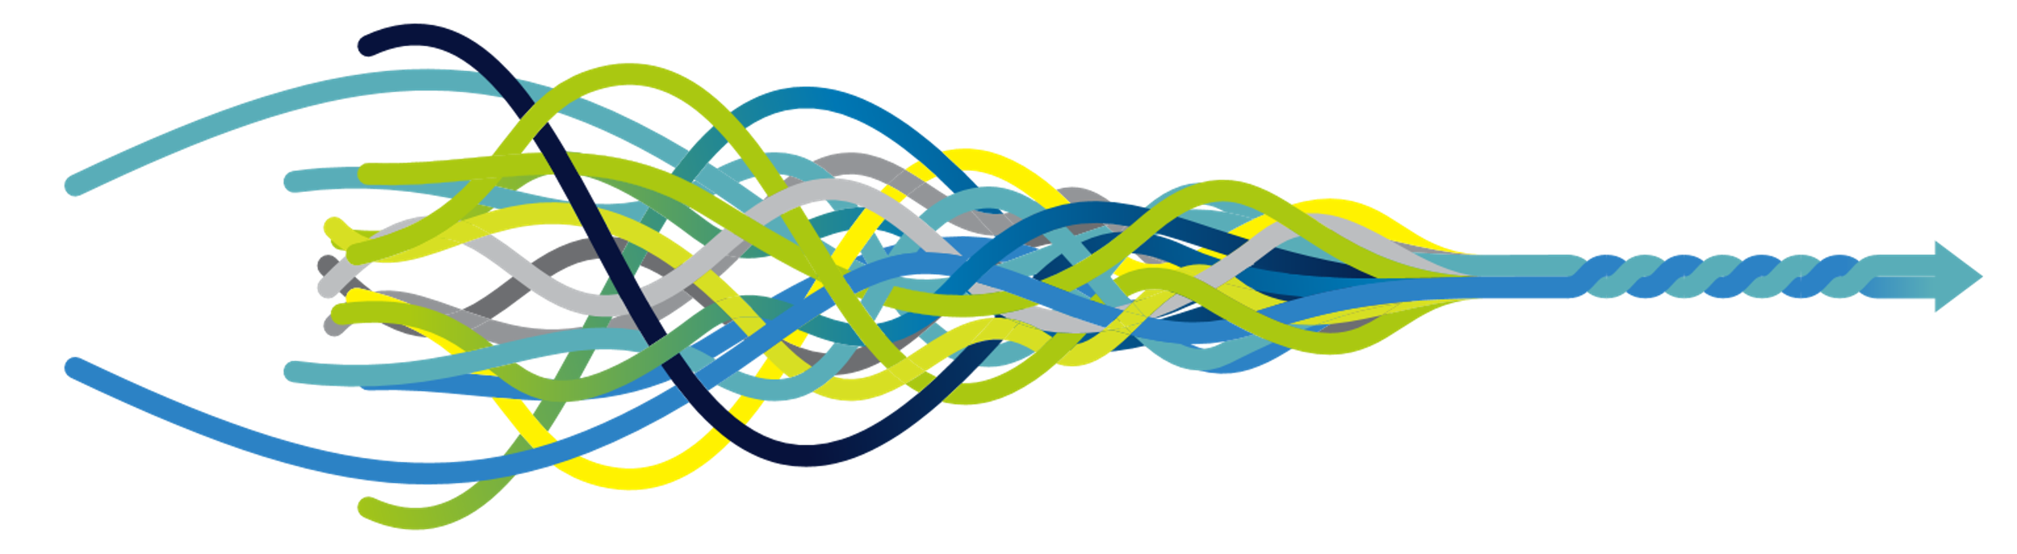
Technology Showcase
Pauli Ohukainen, PhD
Staff Research Scientist
pauli.ohukainen@ouraring.com

Slide 2
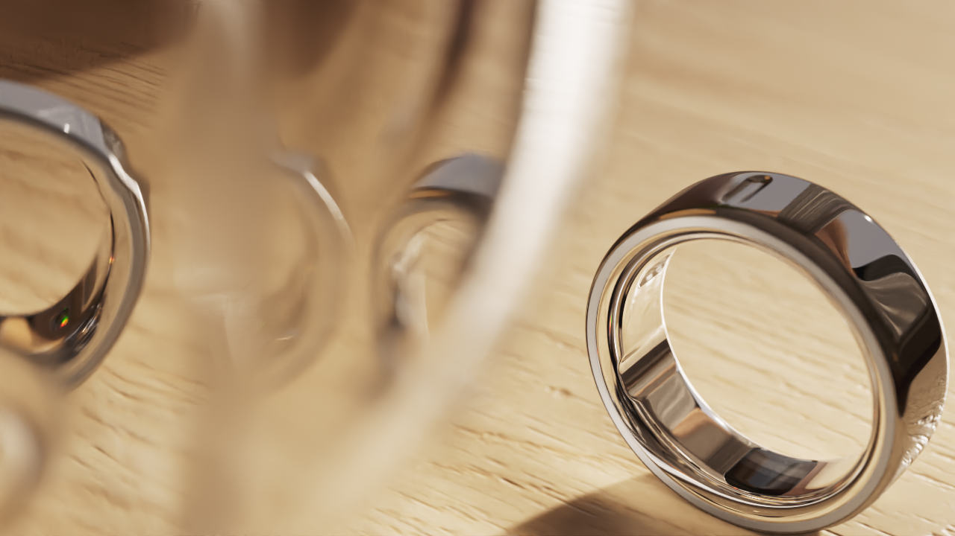






Meet the revolutionary smart ring
Clinical-grade accuracy Utilizing advanced medical-grade sensors, Oura Ring provides reliable, high-precision data across 30+ biometrics.
Continuous data collection Designed for seamless participant wear, it offers up to 7 days of continuous data collection, delivering comprehensive longitudinal health insights ideal for large-scale research projects.
Data accessibility With Oura Teams, you have multiple options for exporting and visualizing data, allowing you to monitor adherence and export in your preferred format at any time.
Data privacy & security Participant data is protected with industry leading privacy and security practices.
Proprietary & Confidential

Slide 3





Designed for Scientists,
By Scientists
100s
of granted and pending patents
Oura has a world-class interdisciplinary science team consisting of several decades of combined R&D experience.
The team includes scientists, engineers, and project managers with expertise in a broad range of health and wellness areas, including sleep, reproductive health, cardio-metabolic health, fitness and performance, stress, and behavioral science.
Oura’s sensing capabilities have also been independently validated in several peer-reviewed publications, including Sleep Health, Physiological Medicine, Frontiers in Sports and Active Living, and Sleep Medicine, and it is a trusted research tool utilized by leading academic institutions.
25+
PhDs working as part of our in-house, interdisciplinary science team
85+
Published, peer-reviewed research studies involving Oura

Slide 4
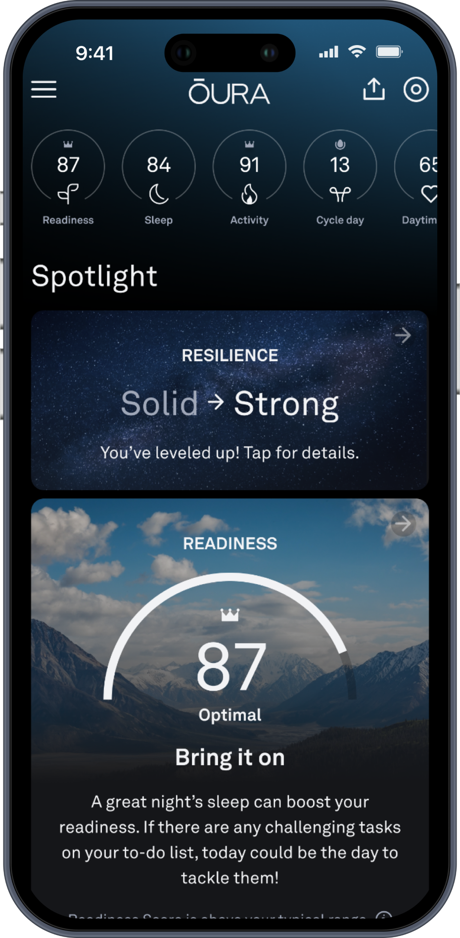







What does Oura Ring measure?
Oura Ring measures 30+ biometrics, including:
Collected data provides insights on:
Blood oxygen sensing
Activity levels
Step tracking
Respiratory rate
HRV balance
Sleep timing and quality
Calorie burn
Cycle Tracking and Period Prediction
Resting heart rate
Inactive times, naps
Daytime heart rate
Automatic activity detection
Heart rate variability (HRV)
Light, deep, and REM sleep
Nighttime movement
Temperature trends
Stress and Resilience
Estimated Pulse Wave Velocity (PWV) - Cardiovascular Age

Slide 5
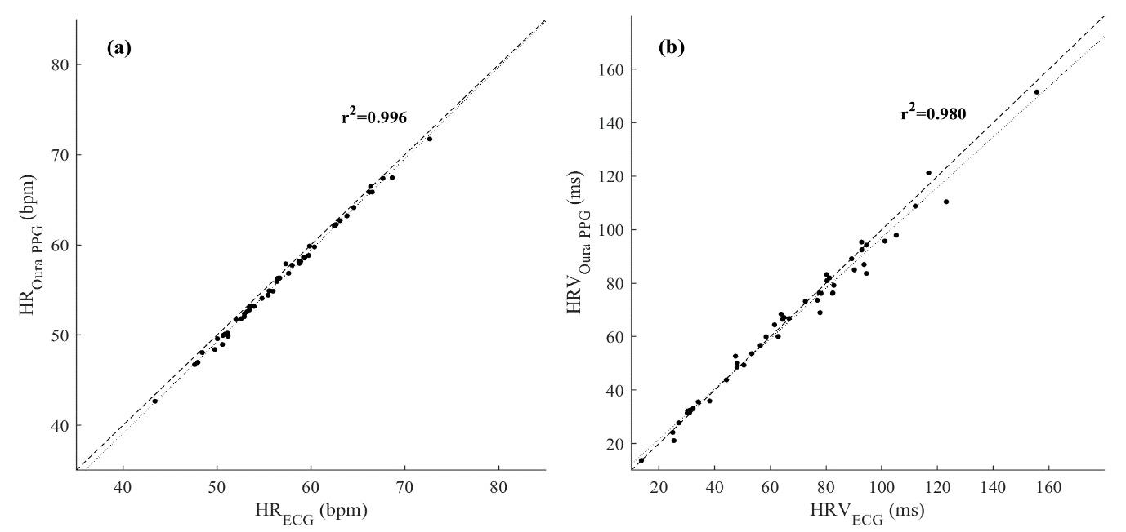
Nocturnal HR and HRV accuracy validated against Gold Standard
Kinnunen H, Rantanen A, Kenttä T, Koskimäki H. Feasible assessment of recovery and cardiovascular health: accuracy of nocturnal HR and HRV assessed via ring PPG in comparison to medical grade ECG. Physiol Meas. 2020 May 7;41(4):04NT01. doi: 10.1088/1361-6579/ab840a. PMID: 32217820.
Notes:
The scientist in me just wanted to show that nocturnal HR and HRV assessed by Oura ring are near to perfect correlation with medical grade ecg before showing the next slides

Slide 6
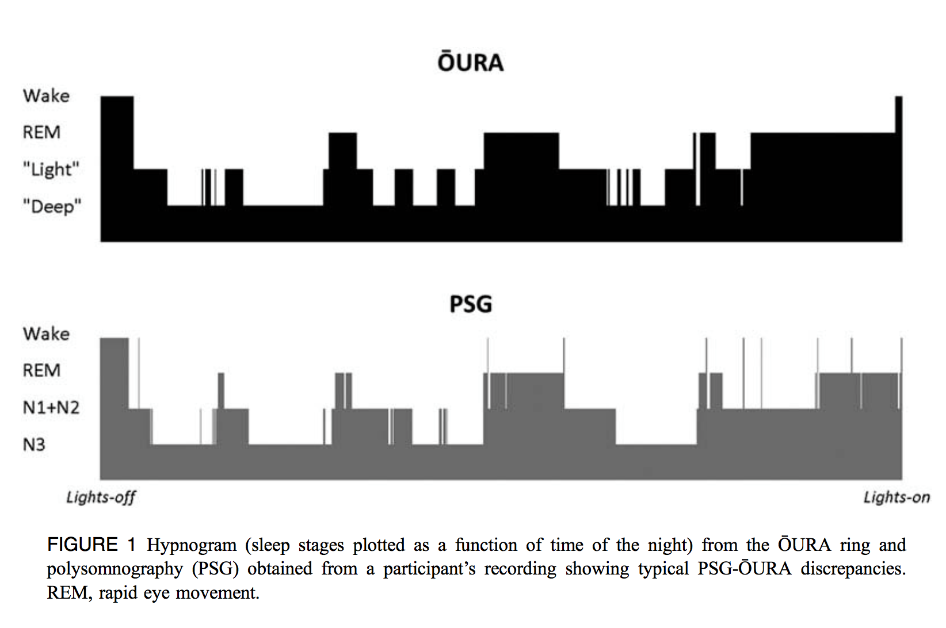
2017: The first independently validated wearable for measuring sleep stages
de Zambotti M, Rosas L, Colrain IM, Baker FC. The Sleep of the Ring: Comparison of the ŌURA Sleep Tracker Against Polysomnography. Behav Sleep Med. 2019 Mar-Apr;17(2):124-136. doi: 10.1080/15402002.2017.1300587. PMID: 28323455;

Slide 7
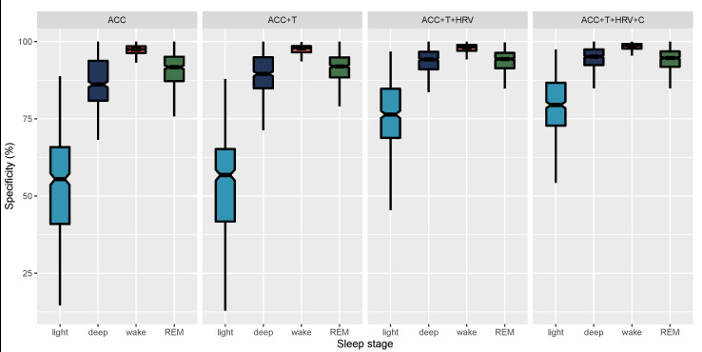
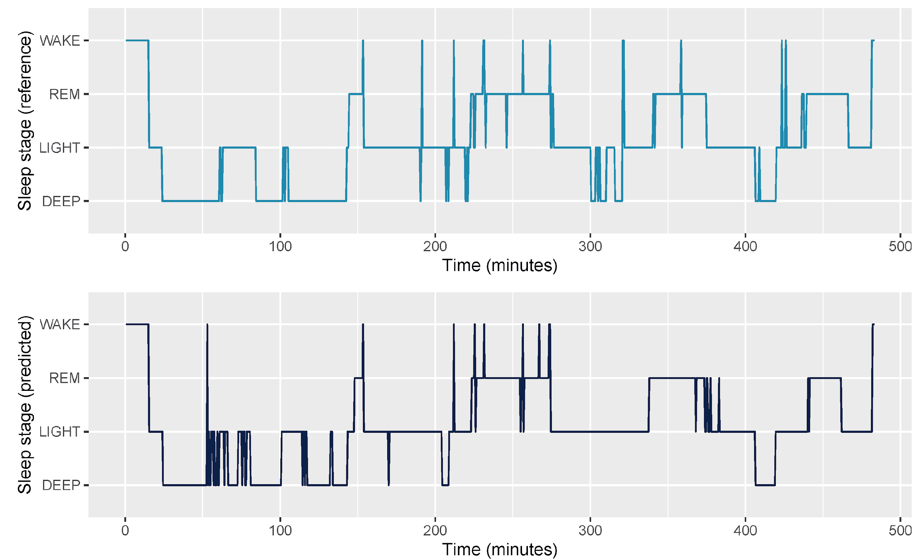
2021: More data, more sophisticated machine learning, more accuracy
Epoch by epoch specificity for 4-stage classification. Whiskers are computed as 1.5 times the interquartile range.
Whole night sleep staging example
Altini M, Kinnunen H. The Promise of Sleep: A Multi-Sensor Approach for Accurate Sleep Stage Detection Using the Oura Ring. Sensors (Basel). 2021 Jun 23;21(13):4302. doi: 10.3390/s21134302. PMID: 34201861

Slide 8
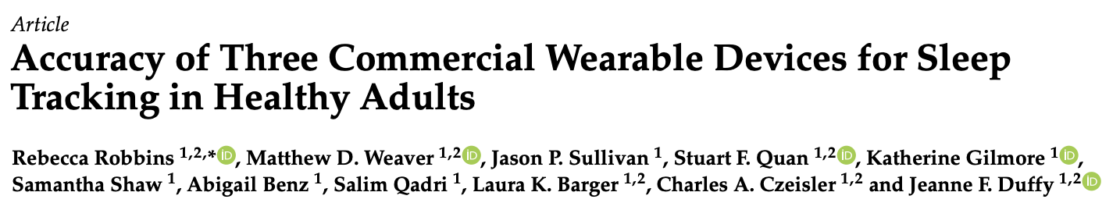
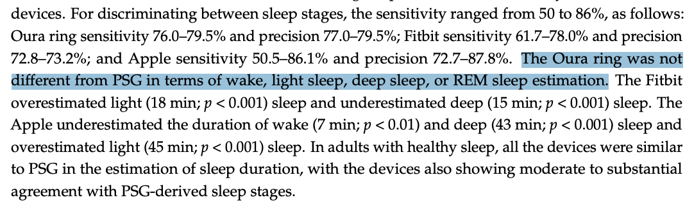
2024: Comparatively excellent performance
Robbins, R.; Weaver, M.D.; Sullivan, J.P.; Quan, S.F.; Gilmore, K.; Shaw, S.; Benz, A.; Qadri, S.; Barger, L.K.; Czeisler, C.A.; et al. Accuracy of Three Commercial Wearable Devices for Sleep Tracking in Healthy Adults. Sensors 2024, 24, 6532

Slide 9
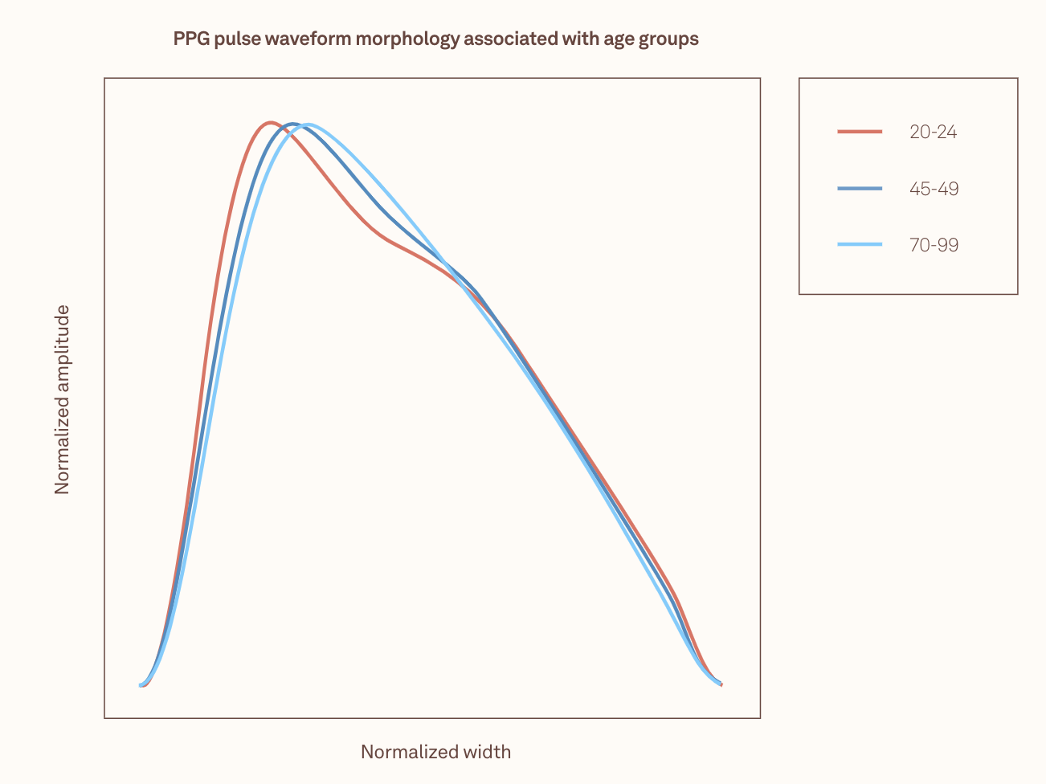
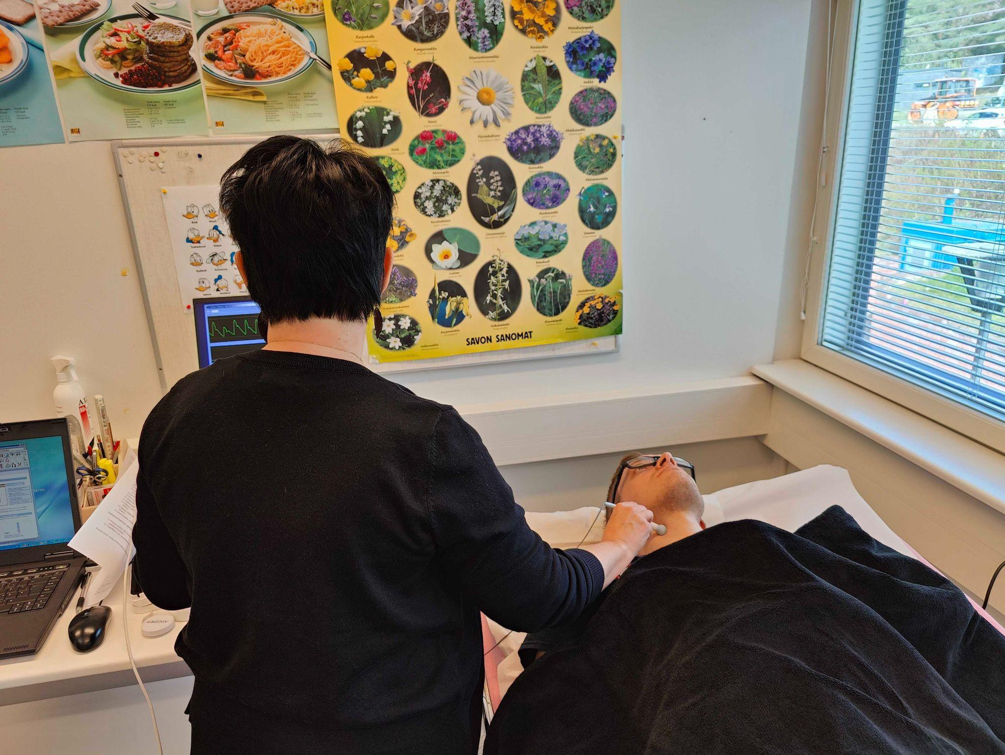
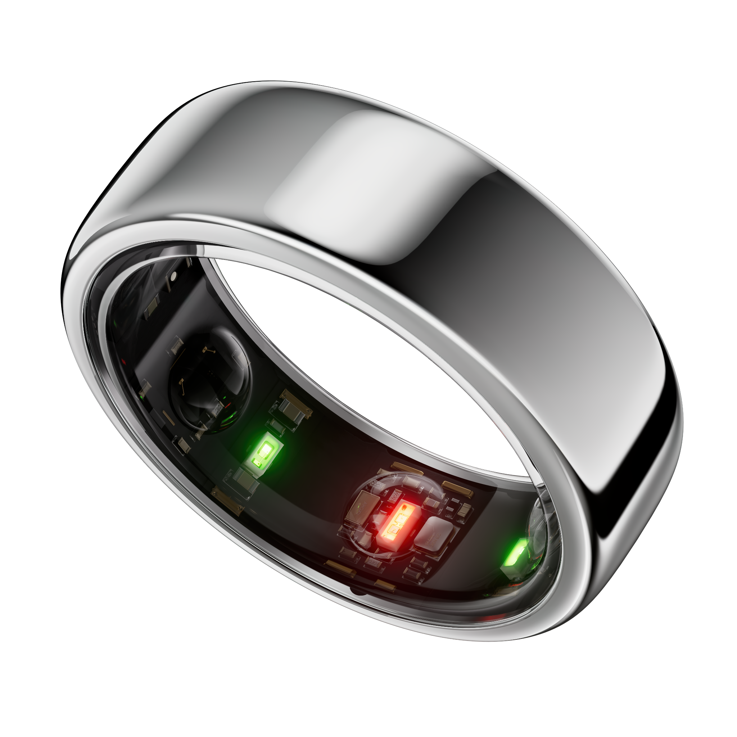
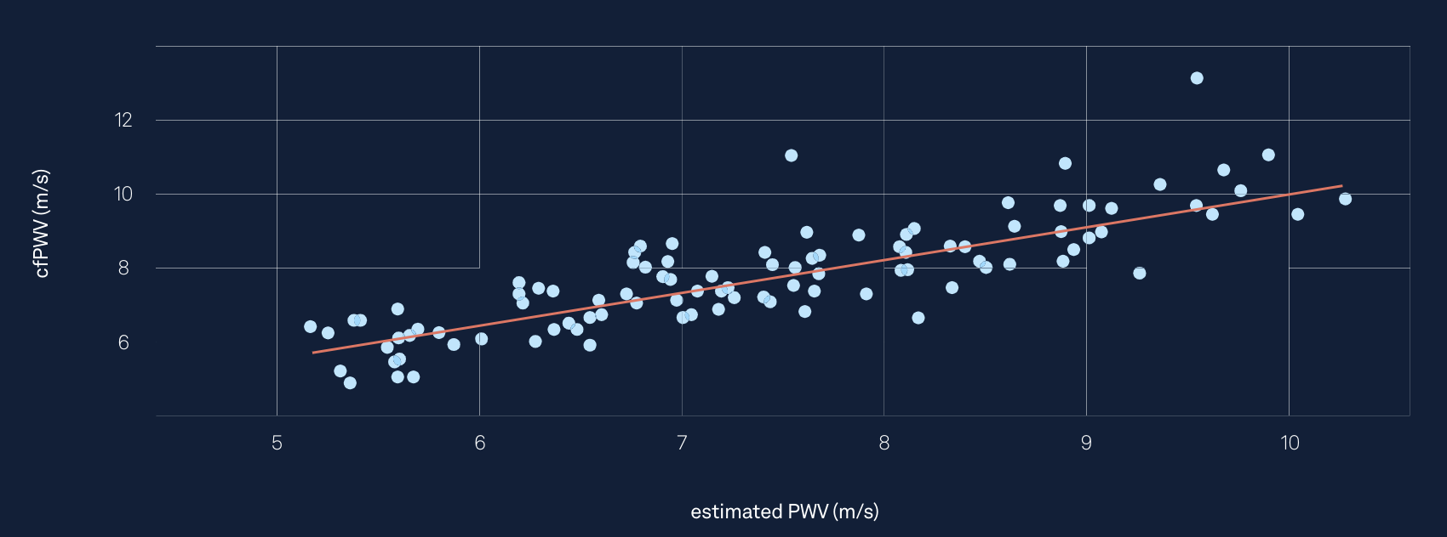
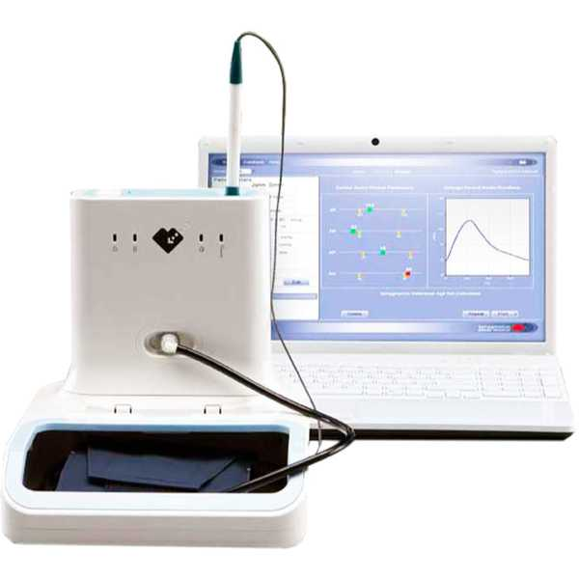
2024: New capabilities launched: estimating arterial stiffness (Cardiovascular Age)
Oura Ring PPG-signal:
R = 0.83
Sphygmocor (clinical reference device):
Source: Cardiovascular Age White Paper, available at: ouraring.com/blog/category/for-business/white-papers (Scientific manuscript being prepared)
Notes:
The figure is from our White Paper

Slide 10

Partner with Science at Oura
There are different opportunities to partner with the Science Team at Oura depending on the proposed project, funding, potential for data sharing, & alignment with company goals.Please work with your Oura contact to find the partnership level that might be most appropriate for your study.
Proprietary & Confidential

Slide 11
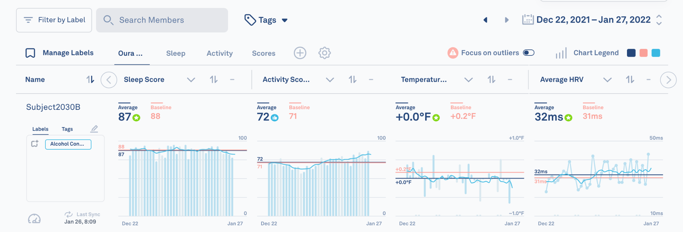
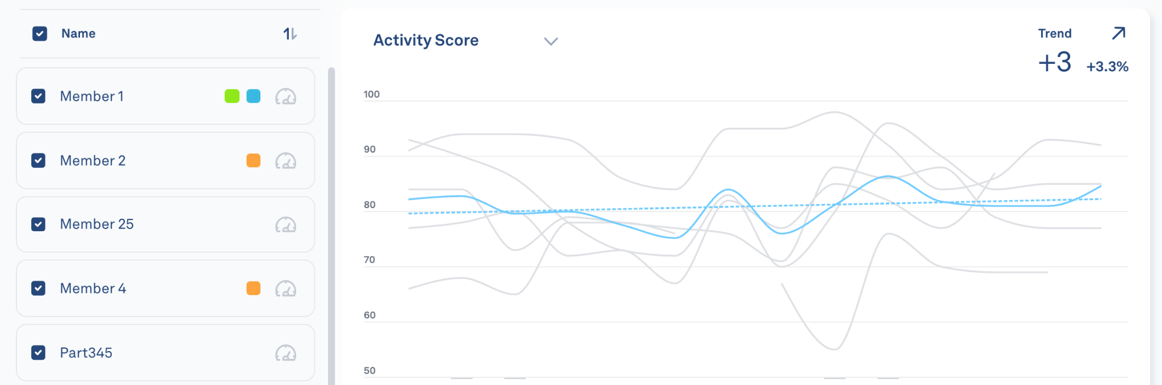
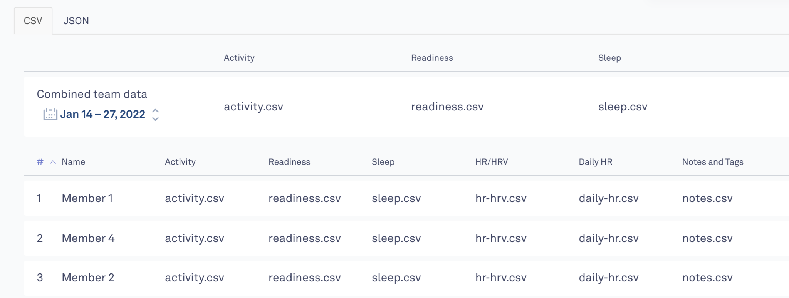
Data Access Options
With your Research package, you gain access to Oura Teams. This platform allows you to monitor participant adherence in real time and export data in your preferred format, ensuring seamless integration into your research workflows.
Oura Teams
GROUP DASHBOARD
GROUP ANALYSIS
DATA EXPORT
Create multiple dashboard views with up to 6 metric sets per screen (31 metrics available)
Ability to filter and view outliers within the data
Compare baseline against current data for each user
Adjust time frame when viewing data
Filter participants by custom labels into cohorts
Download data by individual or group level
Exports are available in .csv or .json format
View trend lines for each metric
Filter trends by cohorts or other labels

Slide 12
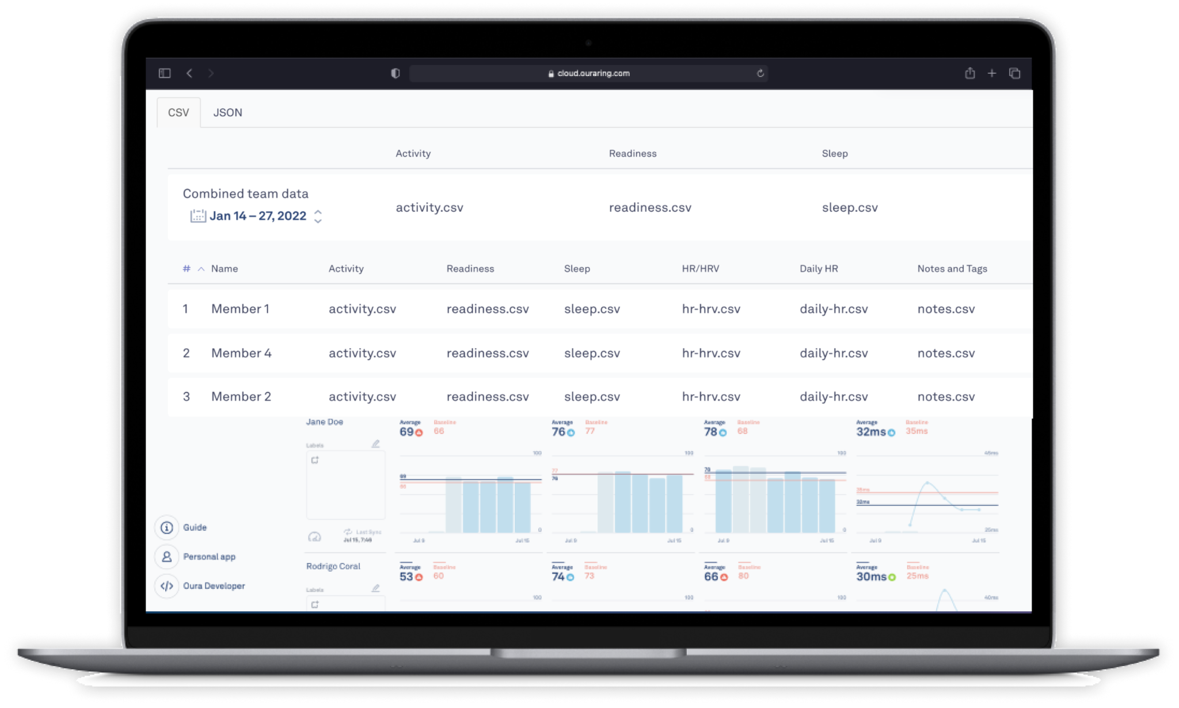
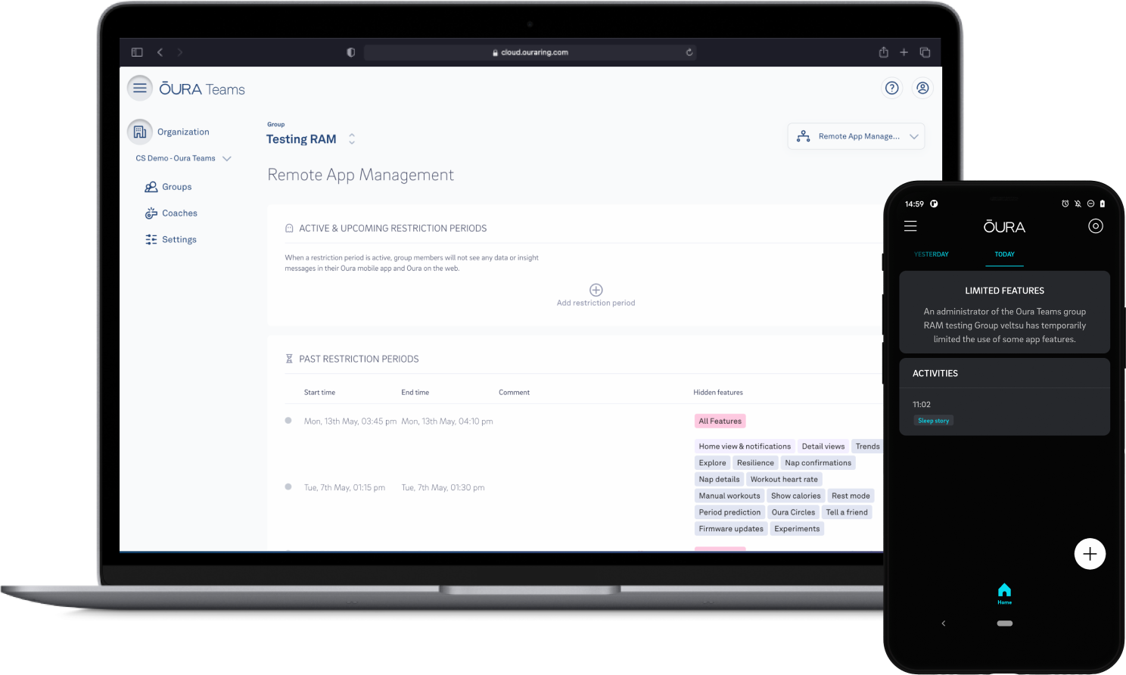
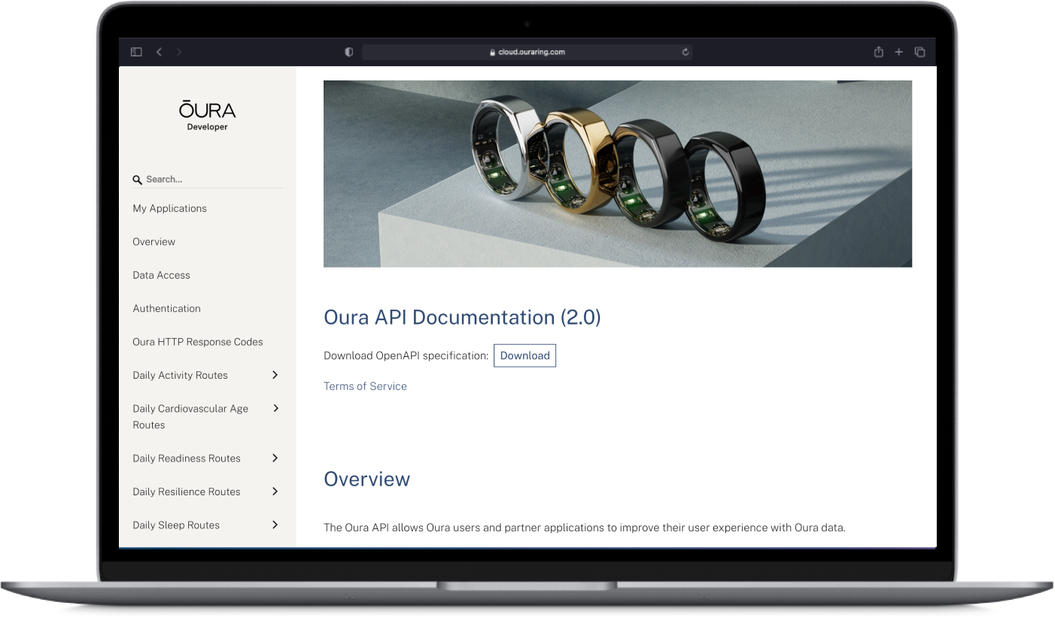
Other Oura Teams Features
Remote App Management
The Oura API
Add and remove admins easily
Ability to purchase additional seats as needed
Option to switch out users during subscription period
Can create multiple groups within one organization
Multiple group settings
Obfuscated vs Identified members - ability to hide participants’ names and email addresses
Private vs Public Groups - ability to restrict who can see participants’ data within a group
Schedule restriction periods to temporarily hide selected metrics and insights in the Oura App for group participants.
While active, participants won’t see the restricted data.
Once the restriction ends, participants regain access to current and past metrics.
The Oura API provides researchers with an easy way to integrate participant metrics into existing systems and processes.
Free and open API, integrated with Apple Health Kit and Google Health Connect.
Data syncs automatically when participants open their Oura App and sync Oura ring.
Requires participants to have an active Oura Membership.
For more details, please refer to our API documentation.

Slide 13
Metrics Available in Oura Teams
With your Research package, you gain access to Oura Teams. This platform allows you to monitor participant adherence in real time and export data in your preferred format, ensuring seamless integration into your research workflows.
Standard Access Metrics (All in alphabetical order)
Activity
Cycle Phases (daily, only available if end user consents to share)
Daytime Heart rate
Activity Score – recorded daily
Steps – single value for the day
Calories – single value for the day
METs – recorded every 5 minutes
Measured for 1 min every 5-10 minutes (bpm)
Predicted cycle phase (luteal or follicular) for a given day
Historical cycle phase predictions are updated daily
Estimated VO2 max value (integer)
Updated after walking test or manual entry
Activity Level – recorded every 5 minutes
Heart rate average (1-min resolution)
Daily Sleep Score
Bedtime latency (seconds)
Sleep Score from 0-100
Based on the following contributors: Deep Sleep, Efficiency, Latency, REM Sleep, Restfulness, Timing and Total Sleep
Only confirmed sleep periods impact calculation
Heart rate lowest (5-min window)
Bedtime Start, Bedtime End (timestamp)
Heart rate time series (5-min resolution)
Heart rate variability average (millisecond)
Cardiovascular Age (CVA) (daily)
Estimated cardiovascular age in years (age)
Heart rate variability time series (5-min resolution)
Proprietary & Confidential

Slide 14
Standard Access Metrics Continued (All in alphabetical order)
Number of Get Ups During Sleep (count)
Sleep efficiency (score)
Workout Heart rate - measured every second when WHR is activated (bpm)
Optimal Sleep Time *main sleep period only*
SpO2 average (percent, only available with membership) *main sleep period only*
Optimal Bedtime (timestamp)
Recommended action – improve efficiency, earlier bedtime, etc.
Tags - user placed tags
Stress and Recovery
Daily summary time spent in each level - stressed, engaged, relaxed, restored (minutes)
Respiratory rate average
Ring Configuration
Model
Serial Number
Temperature Deviation from Baseline (Celcius) *main sleep period only*
Size
Color
60-day rolling baseline
Sleep durations (seconds)
Workout – all metrics are for the recorded workout
Total time in bed
Total sleep (REM + Deep + Light)
REM Total
Deep Total
Light Total
Awake Total
Distance (meters)
Calorie Burn (calories)
Activity name
Intensity (level)
Proprietary & Confidential

Slide 15
Premium Metrics (for academic researchers only)
Interbeat Interval (IBI, milliseconds)
Sleep Hypnogram (30 sec resolution)
Temperature
Integer representation of sleep stages: deep, light, REM, awake
Nightly skin temperature reading (Celsius)
Proprietary & Confidential

Slide 16







Key Considerations
MINIMUM PURCHASEQUANTITY
10 Oura Ring units
PROTOCOL
Oura Ring requires proper sizing for optimal use. Best practice is to size participants before distributing the Oura Ring units. We will provide sizing kits to your study site to ensure accurate fitting.
BASELINE PERIOD
Oura suggests adding an extra 10-14 days of wear to your protocol to help Oura Ring establish baseline data for trend-based metrics, such as temperature variation.
DEVICE REQUIREMENTS
The Oura App is supported on iOS devices running iOS 15 or higher and Android devices running Android 9 or higher with Google Play services. Your device must support Bluetooth 4.0.
OURA & MEDICAL CONDITIONS
The Oura Ring is not a medical device and is not intended to diagnose, treat, cure, monitor, or prevent any medical conditions or illnesses.
GENERAL USE
You can wear your Oura Ring 24/7, as it’s designed for all-day comfort. Battery Life is 5-7 days.
We don’t recommend wearing your Oura Ring adjacent to other rings, as this may cause discomfort or unintended scratching.
For best results, wear your Oura Ring on your non-dominant hand to minimize friction and potential scratches from daily activities.
DAILY SYNC
Syncing the Oura App daily is recommended to ensure the accuracy and completeness of data collection.
Proprietary & Confidential

Slide 17
Thank you for your attention!
For further information, let’s keep in touch:
pauli.ohukainen@ouraring.com
Proprietary & Confidential

